Slide 1
A First Book of ANSI C Fourth Edition
Chapter 2
Getting Started in C Programming

Slide 2
Objectives
Introduction to C Programming
Programming Style
Data Types
Arithmetic Operations

Slide 3
Objectives (continued)
Variables and Declarations
Case Study: Temperature Conversion
Common Programming and Compiler Errors

Slide 4
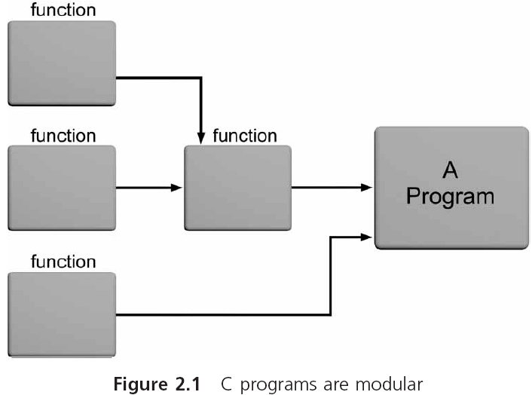
Introduction to C Programming

Slide 5
Introduction to C Programming (continued)
C provides a comprehensive set of functions
Stored in a set of files known as the standard library
The standard library consists of 15 header files

Slide 6
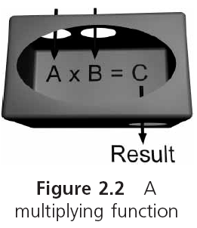
Introduction to C Programming (continued)

Slide 7
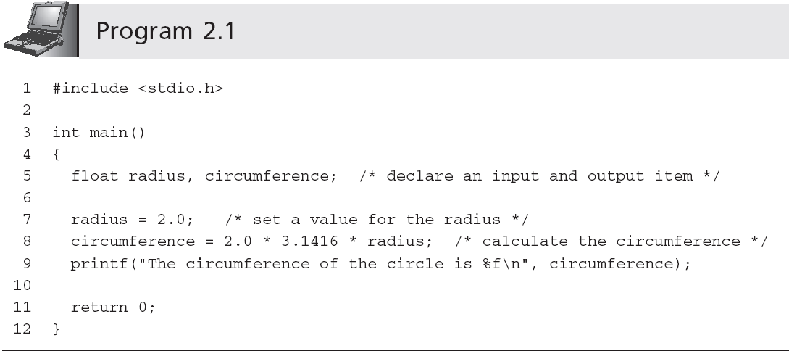
Introduction to C Programming (continued)
Identifiers

Slide 8
Identifiers
Identifiers in C consist of three types:
Reserved words
Standard identifiers
Programmer-created identifiers

Slide 9
Identifiers (continued)
Reserved word: word that is predefined by the programming language for a special purpose and can only be used in a specified manner for its intended purpose
Also referred to as keywords in C

Slide 10
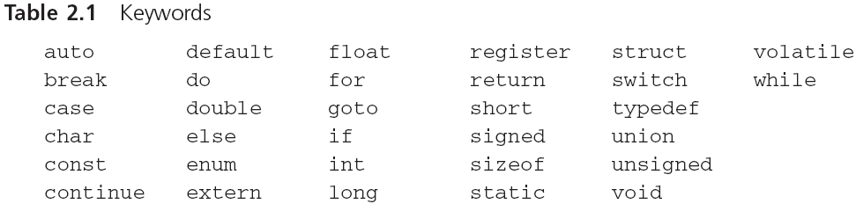
Identifiers (continued)

Slide 11
Identifiers (continued)
Standard identifiers: words predefined in C
Most of the standard identifiers are the names of functions that are provided in the C standard library
It is good programming practice to use standard identifiers only for their intended purpose

Slide 12
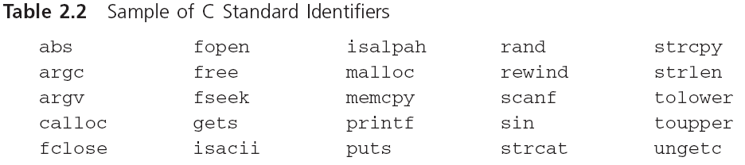
Identifiers (continued)

Slide 13
Identifiers (continued)
Programmer-created identifiers: selected by the programmer
Also called programmer-created names
Used for naming data and functions
Must conform to C’s identifier rules
Can be any combination of letters, digits, or underscores (_) subject to the following rules:
First character must be a letter or underscore (_)
Only letters, digits, or underscores may follow the initial character
Blank spaces are not allowed
Cannot be a reserved word

Slide 14
Identifiers (continued)
Examples of invalid C programmer-created names:
4ab7
calculate total
while
All uppercase letters used to indicate a constant
A function name must be followed by parentheses
An identifier should be descriptive: degToRadians()
Bad identifier choices: easy, duh, justDoIt
C is a case-sensitive language
TOTAL, and total represent different identifiers

Slide 15
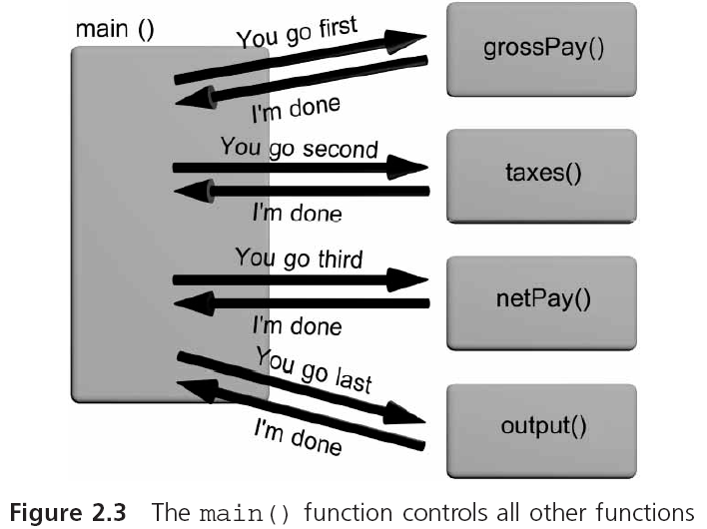
The main() Function
Sometimes referred to as a driver function

Slide 16
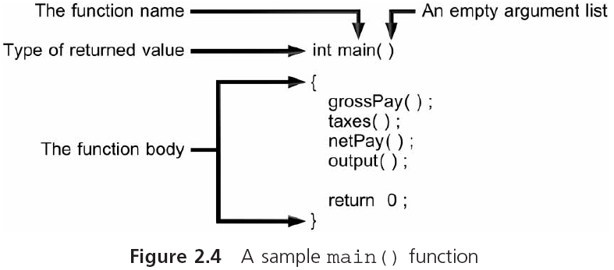
The main() Function (continued)
Function header line
Executable statements

Slide 17
The printf() Function
printf() formats data and sends it to the standard system display device (i.e., the monitor)
Inputting data or messages to a function is called passing data to the function
printf("Hello there world!");
Syntax: set of rules for formulating statements that are “grammatically correct” for the language
Messages are known as strings in C
A string of characters is surrounded by double quotes
printf("Hello there world!");

Slide 18
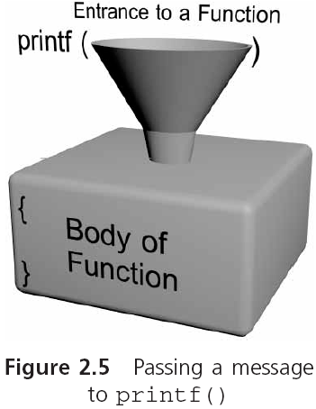
The printf() Function (continued)
Function arguments

Slide 19
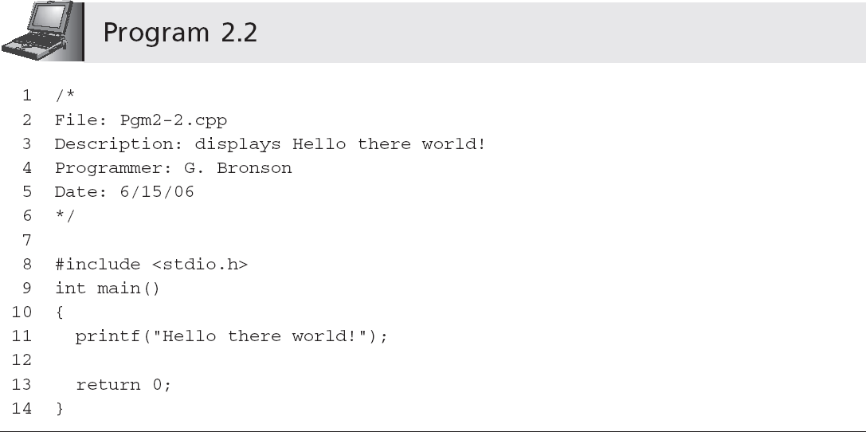
The printf() Function (continued)
Comment
Preprocessor command
Header file
Invoking or calling the printf() function

Slide 20
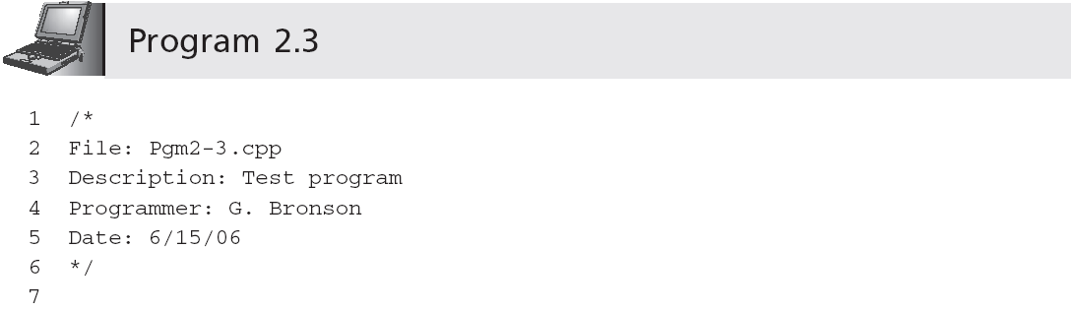
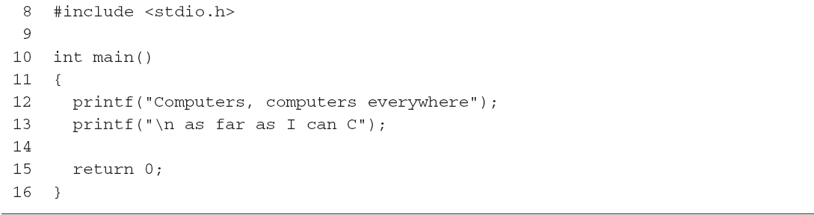
The printf() Function (continued)
Output is:
Computers, computers everywhere
as far as I can C
Newline escape sequence

Slide 21
Programming Style: Indentation
Except for strings, function names, and reserved words, C ignores all white space
White space: any combination of one or more blank spaces, tabs, or new lines
In standard form:
A function name is placed, with the parentheses, on a line by itself starting at the left-hand corner
The opening brace follows on the next line, under the first letter of the function name
The closing function brace is placed by itself at the start of the last line of the function

Slide 22
Programming Style: Indentation (continued)
Within the function itself, all program statements are indented two spaces
Indentation is another sign of good programming practice, especially if the same indentation is used for similar groups of statements
Don’t do this:
int
main
(
){printf
("Hello there world!"
);return 0;}

Slide 23
Programming Style: Comments
Comments help clarify what a program does, what a group of statements is meant to accomplish, etc.
The symbols /*, with no white space between them, designate the start of a comment; the symbols */ designate the end of a comment
/* this is a comment */
Comments can be placed anywhere within a program and have no effect on program execution
Under no circumstances may comments be nested
/* this comment is /* always */ invalid */

Slide 24
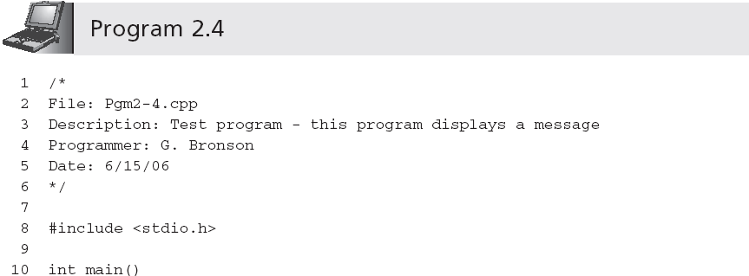
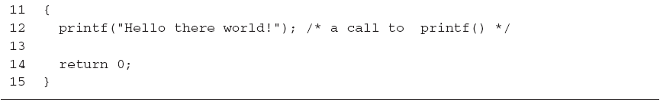
Programming Style: Comments (continued)

Slide 25
Data Types
Data type: set of values and a set of operations that can be applied to these values
Built-in data type: is provided as an integral part of the language; also known as primitive type

Slide 26
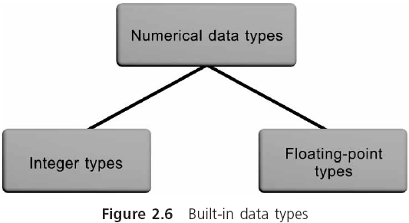
Data Types (continued)

Slide 27
Data Types (continued)
A literal is an acceptable value for a data type
Also called a literal value or constant
2, 3.6, −8.2, and "Hello World!" are literal values because they literally display their values

Slide 28
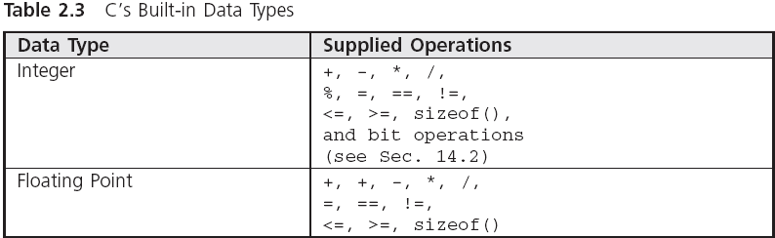
Data Types (continued)

Slide 29
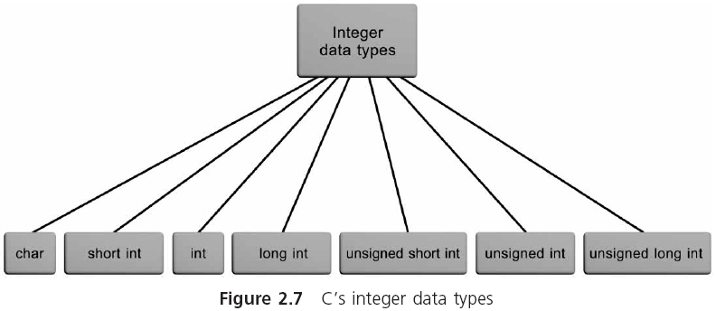
Integer Data Types

Slide 30
Integer Data Types (continued)
int: whole numbers (integers)
For example: 0, -10, 253, -26351
Not allowed: commas, decimal points, special symbols
char: stores individual characters (ASCII)
For example: 'A', '$', 'b', '!'

Slide 31
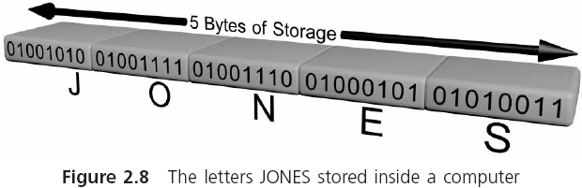
Integer Data Types (continued)

Slide 32
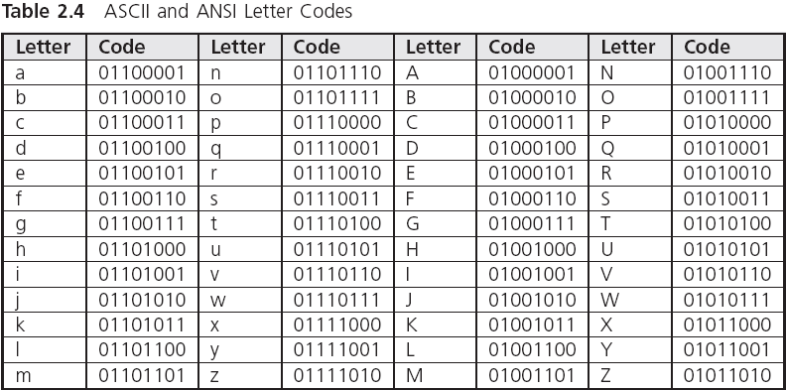
Integer Data Types (continued)

Slide 33
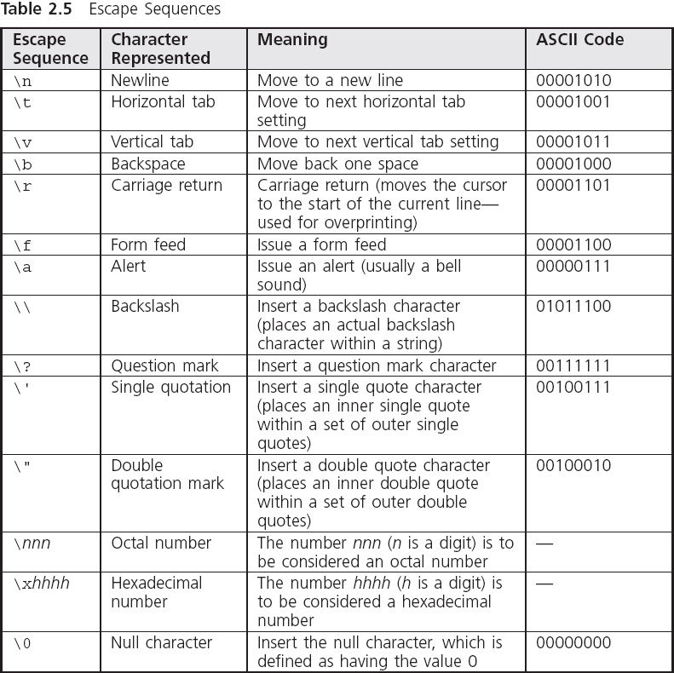
Integer Data Types (continued)

Slide 34
Floating-Point Data Types
A floating-point value (real number) can be the number zero or any positive or negative number that contains a decimal point
For example: +10.625, 5., -6.2, 3251.92, +2
Not allowed: commas, decimal points, special symbols
float: single-precision number
double: double-precision number
Storage allocation for each data type depends on the compiler (use sizeof())

Slide 35
Floating-Point Data Types (continued)
float literal is indicated by appending an f or F
long double is created by appending an l or L
9.234 indicates a double literal
9.234f indicates a float literal
9.234L indicates a long double literal

Slide 36
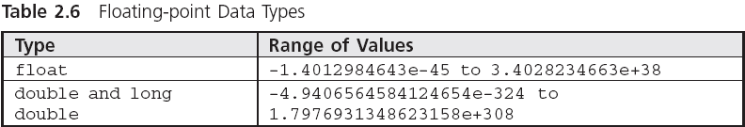
Floating-Point Data Types (continued)

Slide 37
Exponential Notation
In numerical theory, the term precision typically refers to numerical accuracy

Slide 38
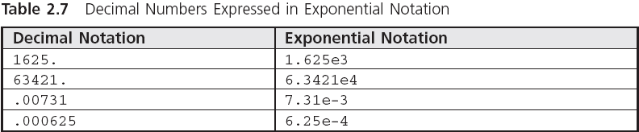
Exponential Notation (continued)

Slide 39
Arithmetic Operations
Arithmetic operators: operators used for arithmetic operations:
Addition +
Subtraction -
Multiplication *
Division /
Modulus Division %
Binary operators require two operands
An operand can be either a literal value or an identifier that has a value associated with it

Slide 40
Arithmetic Operations (continued)
A simple binary arithmetic expression consists of a binary arithmetic operator connecting two literal values in the form:
literalValue operator literalValue
3 + 7
12.62 - 9.8
.08 * 12.2
12.6 / 2.
Spaces around arithmetic operators are inserted for clarity and can be omitted without affecting the value of the expression

Slide 41
Displaying Numerical Values
Arguments are separated with commas
printf("The total of 6 and 15 is %d", 6 + 15);
First argument of printf() must be a string
A string that includes a conversion control sequence, such as %d, is termed a control string
Conversion control sequences are also called conversion specifications and format specifiers
printf() replaces a format specifier in its control string with the value of the next argument
In this case, 21

Slide 42
Displaying Numerical Values (continued)
printf("The total of 6 and 15 is %d", 6 + 15);
The total of 6 and 15 is 21
printf ("The sum of %f and %f is %f", 12.2, 15.754, 12.2 + 15.754);
The sum of 12.200000 and 15.754000 is 27.954000

Slide 43
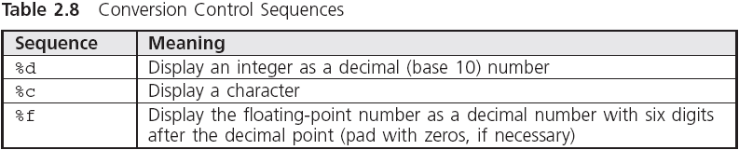
Displaying Numerical Values (continued)

Slide 44
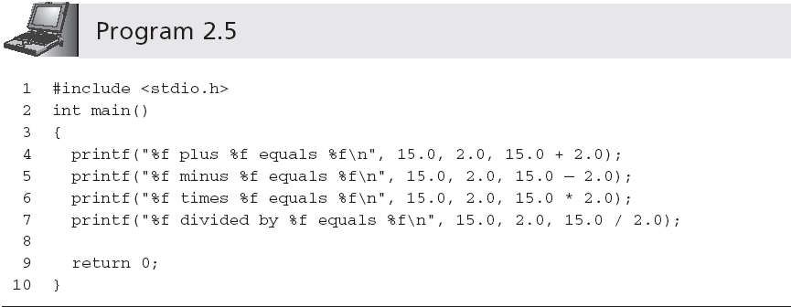
Displaying Numerical Values (continued)

Slide 45
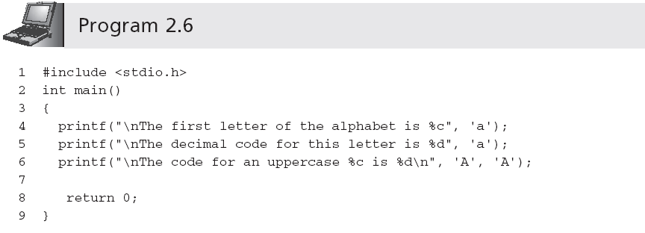
Displaying Numerical Values (continued)

Slide 46
Expression Types
Expression: any combination of operators and operands that can be evaluated to yield a value
Integer expression: contains only integer operands; the result is an integer
Floating-point expression: contains only floating-point operands; the result is a double-precision
In a mixed-mode expression the data type of each operation is determined by the following rules:
If both operands are integers, result is an integer
If one operand is real, result is double-precision

Slide 47
Integer Division
15/2 = 7
Integers cannot contain a fractional part
Remainder is truncated
% is the modulus or remainder operator
9 % 4 is 1
17 % 3 is 2
14 % 2 is 0

Slide 48
Negation
A unary operator is one that operates on a single operand, e.g., negation (-)
The minus sign in front of a single numerical value negates (reverses the sign of) the number

Slide 49
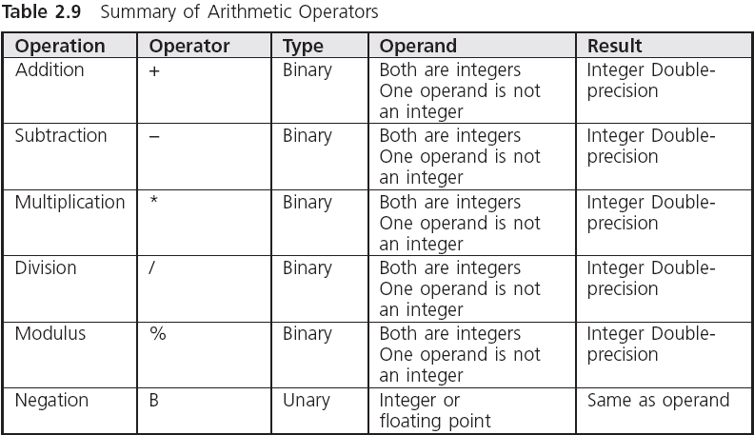
Negation (continued)

Slide 50
Operator Precedence and Associativity
Two binary arithmetic operator symbols must never be placed side by side
Parentheses may be used to form groupings
Expressions in parentheses are evaluated first
Parentheses may be enclosed by other parentheses
Parentheses cannot be used to indicate multiplication

Slide 51
Operator Precedence and Associativity (continued)
Three levels of precedence:
All negations are done first
Multiplication, division, and modulus operations are computed next; expressions containing more than one of these operators are evaluated from left to right as each operator is encountered
Addition and subtraction are computed last; expressions containing more than one addition or subtraction are evaluated from left to right as each operator is encountered

Slide 52
Operator Precedence and Associativity (continued)
Example:
8 + 5 * 7 % 2 * 4 =
8 + 35 % 2 * 4 =
8 + 1 * 4 =
8 + 4 = 12

Slide 53
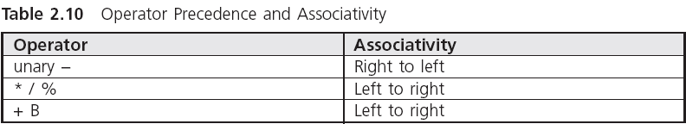
Operator Precedence and Associativity (continued)

Slide 54
Variables and Declarations
Variables are names given by programmers to computer storage
Variable name usually limited to 255 characters
Variable names are case sensitive

Slide 55
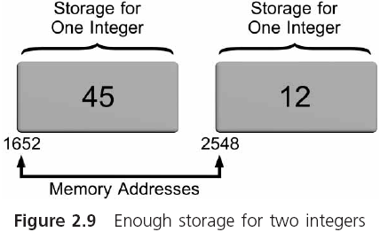
Variables and Declarations (continued)

Slide 56
Variables and Declarations (continued)
num1 = 45;
num2 = 12;
total = num1 + num2;
Assignment statements

Slide 57
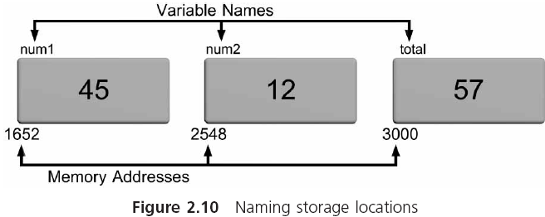
Variables and Declarations (continued)

Slide 58
Declaration Statements
Naming and specifying the data type that can be stored in each variable is accomplished using declaration statements
Declaration statements within a function appear immediately after the opening brace of a function
function name()
{
declaration statements;
other statements;
}
Definition statements define or tell the compiler how much memory is needed for data storage

Slide 59
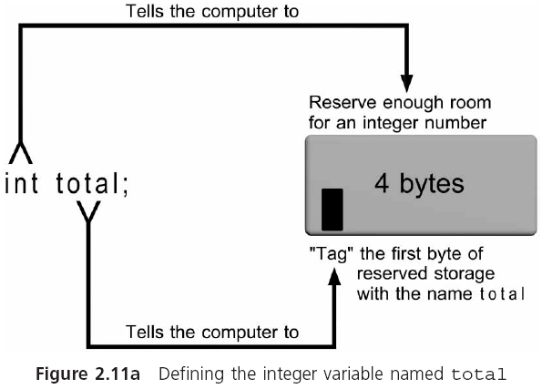
Declaration Statements (continued)

Slide 60
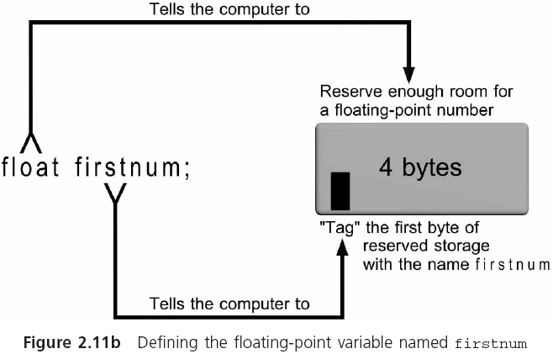
Declaration Statements (continued)

Slide 61
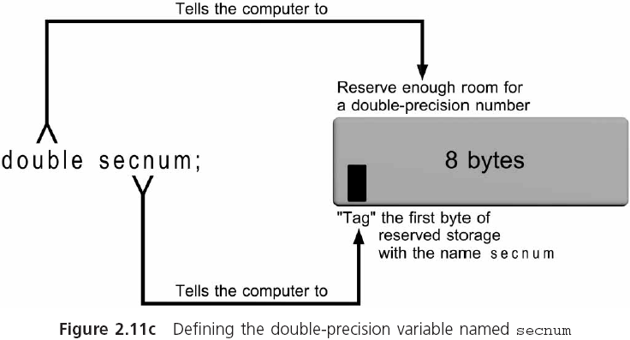
Declaration Statements (continued)

Slide 62
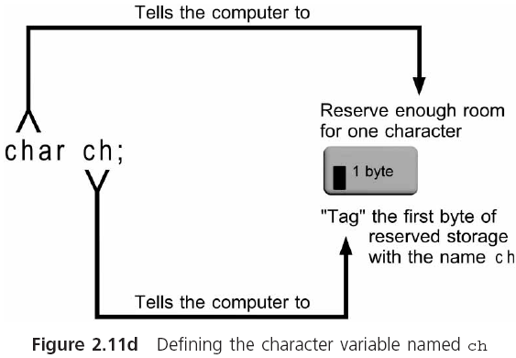
Declaration Statements (continued)

Slide 63
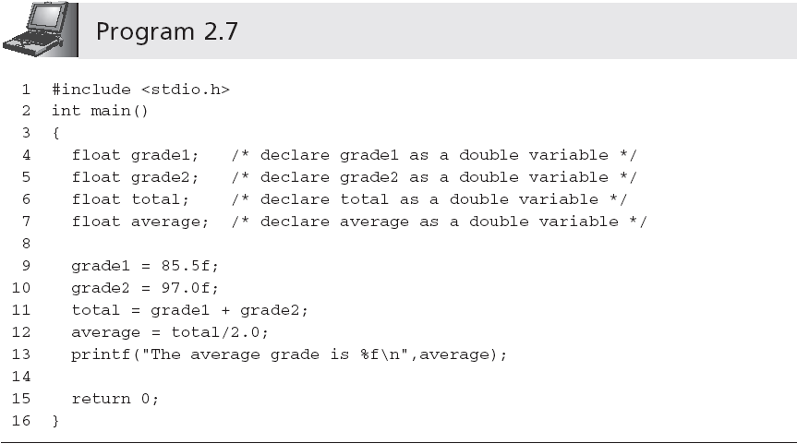
Declaration Statements (continued)
You can omit the f and let the compiler convert the double precision value into a float value when the assignment is made

Slide 64
Selecting Variable Names
Make variable names descriptive
Limit variable names to approximately 20 characters
Start the variable name with a letter, rather than an underscore (_)
In a variable name consisting of several words, capitalize the first letter of each word after the first

Slide 65
Selecting Variable Names (continued)
Use variable names that indicate what the variable corresponds to, rather than how it is computed
Add qualifiers, such as Avg, Min, Max, and Sum to complete a variable’s name where appropriate
Use single-letter variable names, such as i, j, and k, for loop indexes

Slide 66
Initialization
Declaration statements can be used to store an initial value into declared variables
int numOne = 15;
When a declaration statement provides an initial value, the variable is said to be initialized
Literals, expressions using only literals such as 87.0 + 12 − 2, and expressions using literals and previously initialized variables can all be used as initializers within a declaration statement

Slide 67
Case Study: Temperature Conversion
A friend of yours is going to Spain, where temperatures are reported using the Celsius temperature scale. She has asked you to provide her with a list of temperatures in degrees Fahrenheit, and the equivalent temperature in degrees Celsius. The formula relating the two temperatures is Celsius = 5/9(Fahrenheit − 32). Initially, you are to write and test a program that correctly converts the Fahrenheit temperature of 75 degrees into its Celsius equivalent.

Slide 68
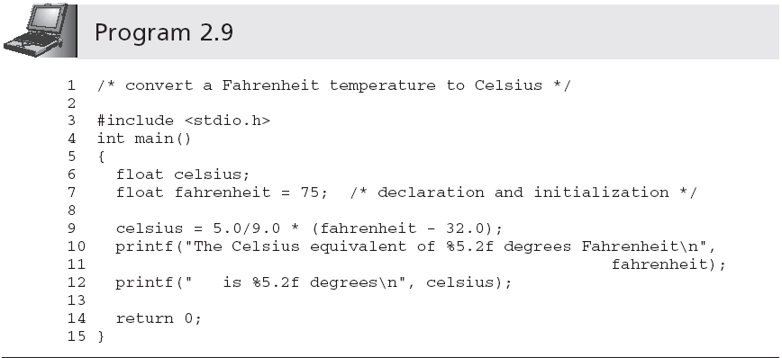
Case Study: Temperature Conversion (continued)

Slide 69
Common Programming Errors
Omitting the parentheses, (), after main
Omitting or incorrectly typing the opening brace, {, that signifies the start of a function body
Omitting or incorrectly typing the closing brace, }, that signifies the end of a function
Misspelling the name of a function; for example, typing print() instead of printf()
Forgetting to close a string passed to printf() with a double quote symbol

Slide 70
Common Programming Errors (continued)
Omitting the semicolon at the end of each executable statement
Forgetting to include \n to indicate a new line
Forgetting to declare all the variables used in a program
Storing an incorrect data type in a declared variable
Using a variable in an expression before a value has been assigned to the variable

Slide 71
Common Programming Errors (continued)
Dividing integer values incorrectly
Mixing data types in the same expression without clearly understanding the effect produced
Not including the correct conversion control sequence in printf() function calls for the data types of the remaining arguments
Not closing the control string in printf() with a double quote symbol followed by a comma when additional arguments are passed to printf()
Forgetting to separate all arguments passed to printf() with commas

Slide 72
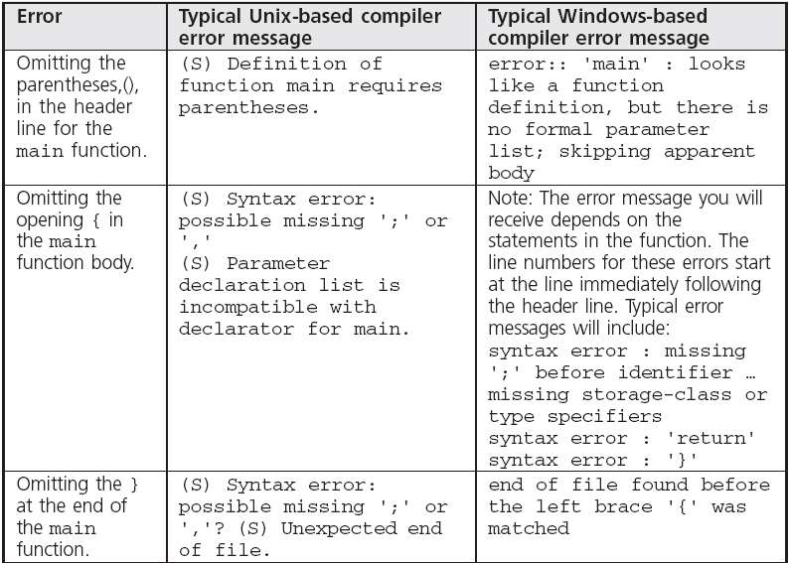
Common Compiler Errors

Slide 73
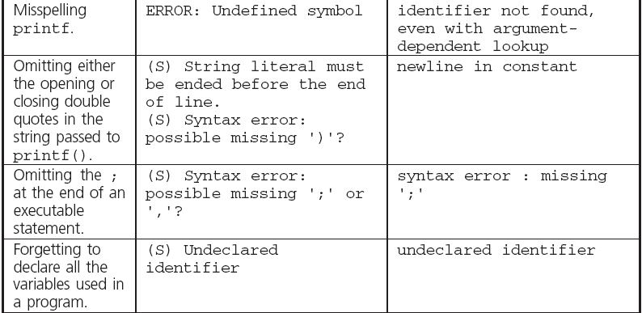
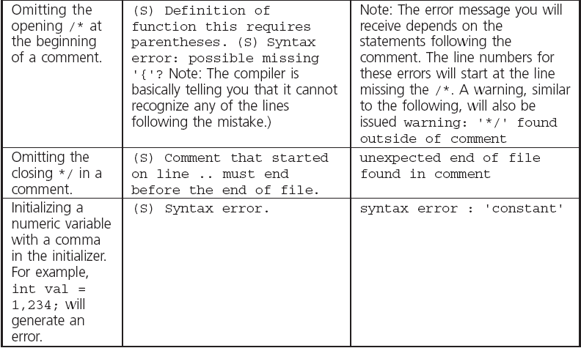
Common Compiler Errors (continued)

Slide 74
Summary
A C program consists of one or more functions
A function is a C language description of an algorithm
Many functions are supplied in a standard library of functions provided with each C compiler
Simple C programs consist of the single function named main()
An executable statement causes some specific action to be performed when the program is executed

Slide 75
Summary (continued)
All executable C statements must be terminated by a semicolon
The printf() function displays text or numerical results
The two basic numerical data types used almost exclusively in current C programs are integers and double-precision numbers
An expression is a sequence of one or more operands separated by operators

Slide 76
Summary (continued)
Expressions are evaluated according to the precedence and associativity of the operators used
printf() can display all of C’s data types
Every variable in a C program must be
Declared with a data type
Used after it is declared
Declaration statements inform the compiler of a function’s valid variable names

